Slide 2
Teacher’s Identity
Md. Jasim Madbar
Assistant Teacher (English)
Shibchar Nanda Kumar Model Instituion

Slide 3
Class Identity
Class: Viii
Subject: English
Unit: One
Lesson: Two
Time: 40 Minutes
Date: 10 January, 2015

Slide 4
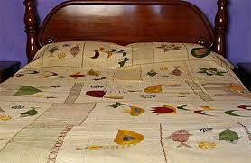

Slide 5
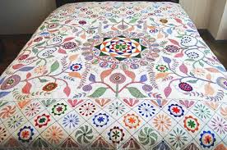
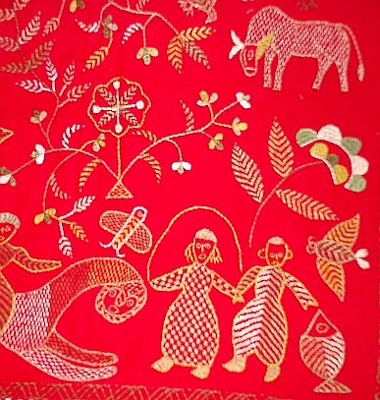

Slide 6
Todays Topic
Nakshi Kantha

Slide 7
Objectives:
Students will be able to define nakshi kantha.
2. They will be able to tell the places where it is found and how it is made.
3. They will be able to make sentences with new words.

Slide 8
Pair Work
Discuss with your partner about the picture and write the answer of the question given below.
*What is Nakshi Kantha?

Slide 9
Individual Work
Read the text in your book silently.
If you fail, take my help.

Slide 10
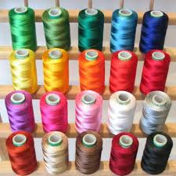
Thread

Slide 11
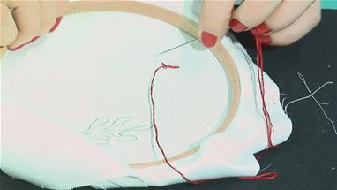
Nakshi Kantha is being made
Needle
Old or New Clothe + Thread + Needle = Nakshi Kantha

Slide 12
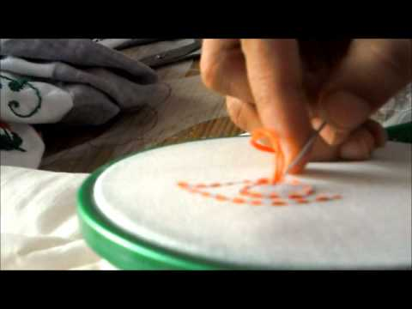

Slide 13
Let’s Watch a Video

Slide 14
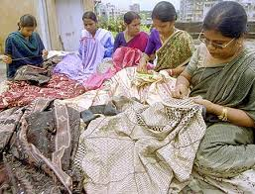

Slide 15
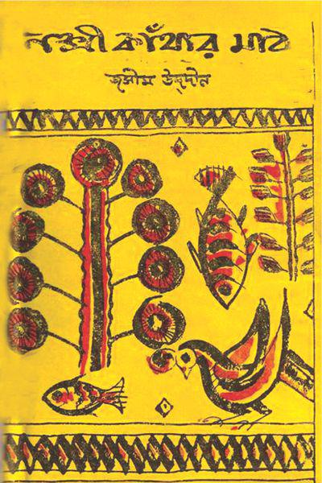
Jasim Uddin and
His Famous Creation

Slide 16
Individual Work
Answer the questions:
a) What are needed to make Nakshi Kantha?
b) How to make a Nakshi Kantha?
c) When has it become popular?
d) Where is it found?

Slide 17
Group Work
Make sentences with the new words given below:
demand, design, popular, rural, artistic,

Slide 18
Home Work
Write a paragraph about Naksha Kantha.

Slide 19
Thanks

